Slide 1

The computer is not our master, but our child. We must teach it that way.

Slide 2
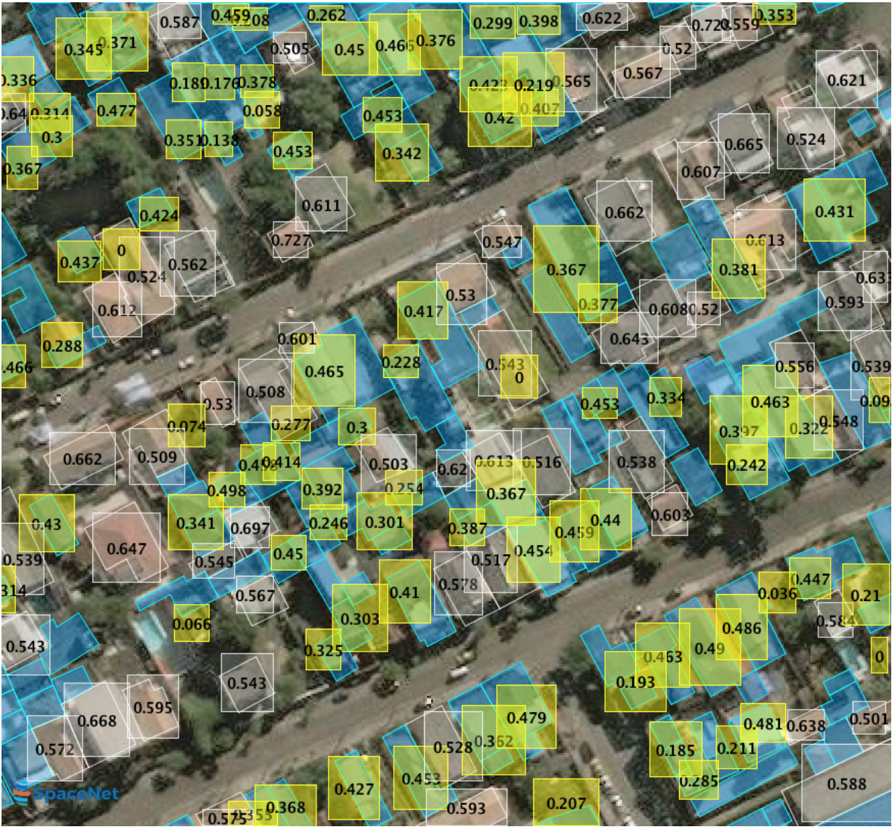
OBJECTIVE
To extract rooftops from a satellite image of an area, including densely built regions such as slums and villages, and implement a Machine Learning algorithm in it.
To make it such that each rooftop is individually accessible, and an action of choice can be performed on it, such as additional information display.
To automate this process, such that it doesn’t need constant tweaking from the developer.

Slide 3

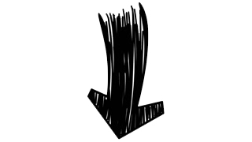



Tools Used
TensorFlow

Slide 4
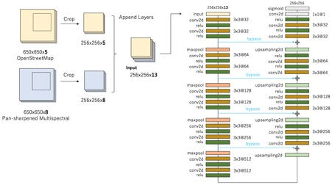
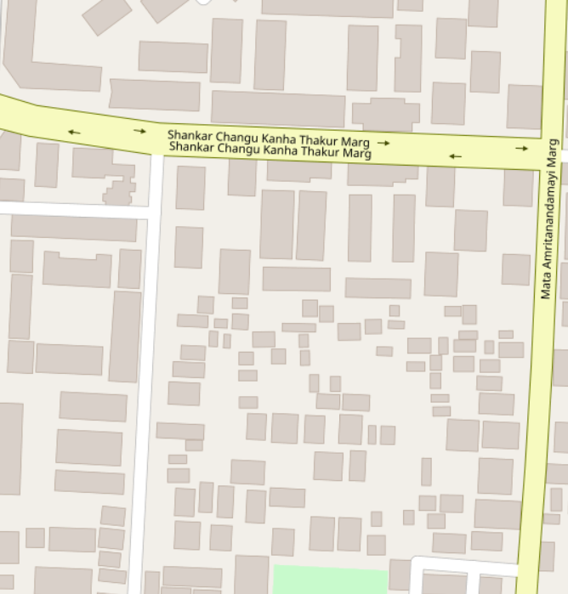
The SpaceNet Challenge and the winner’s implementation
Approach 1

Slide 5
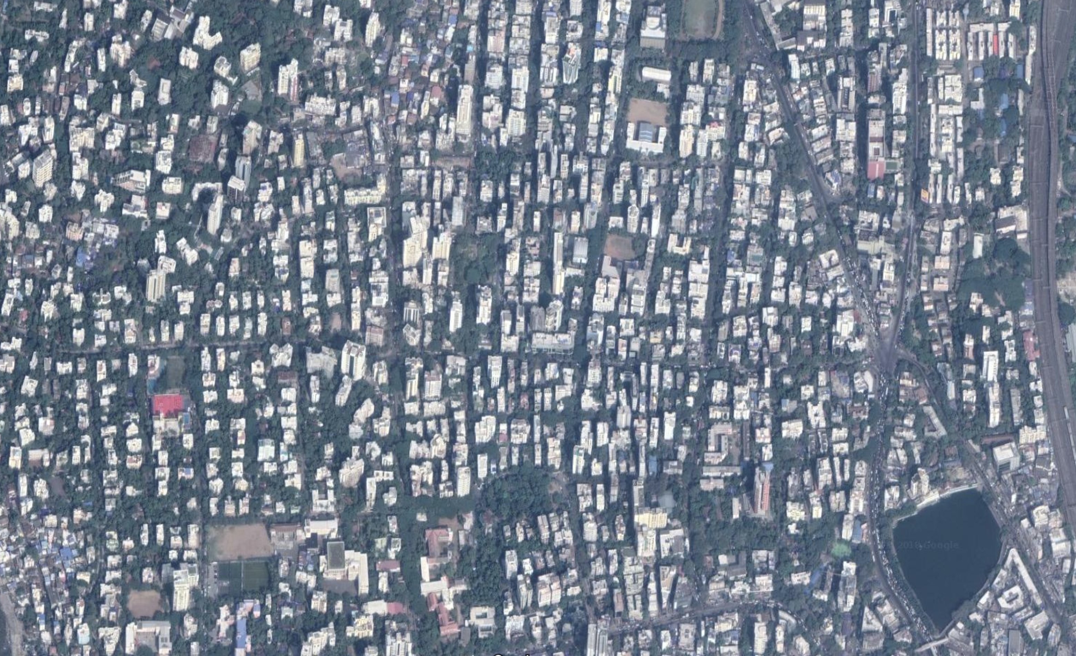
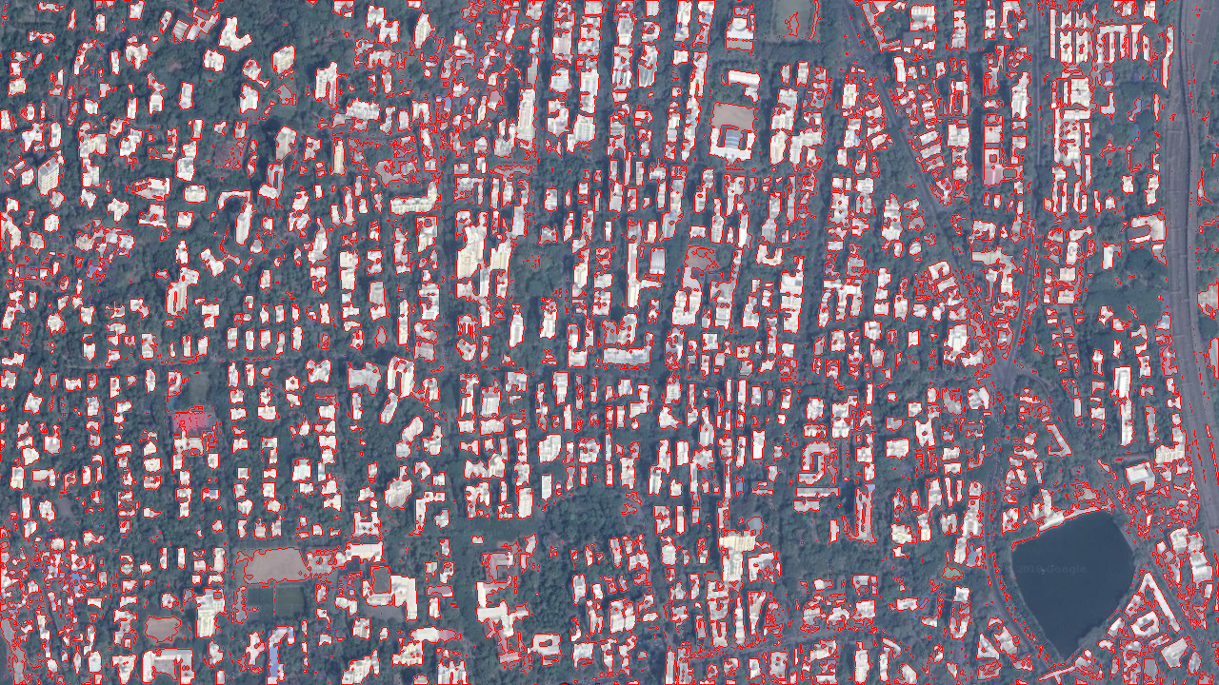

MANUAL IMAGE PROCESSING
Approach 2
The approach was to make an XML file containing multiple satellite images with rooftops marked on them. So we first processed an image to make borders (“contours”) around all rooftops.

Slide 6
OUR PROCESS
STEP | DETAILS | TOOLS AND PACKAGES USED
1. Reading the image | Reads the image and stores it on the system | OpenCV
2. Applying Gray-scale | Makes the image B/W, removing all colors | OpenCV
3. Blur and Noise Removal (*) | Blurs out the image to round the sharp corners and remove noise | OpenCV, NumPy
4. Thresholding (*) | The image is converted to binary form by applying a threshold condition. | OpenCV (THRESH_BINARY+THRESH_OTSU)
5. Get Contours | The command will store the location of all the boundaries it finds in the image. | OpenCV, NumPy
6. Draw Contours and write to file | This will draw out the contours in the locations that it has first identified it | OpenCV (DrawContours with RETR_EXTERNAL hierarchy system)
7. Create Contour Vector | Digitising contours to geo-vectors in WGS 84 datum with EPSG 4326 projection.

Slide 7
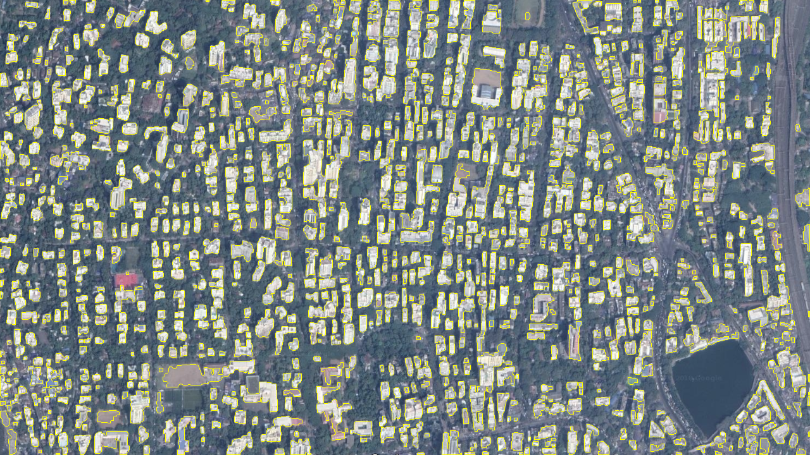
OUTPUT AND CONCLUSIONS

Slide 8
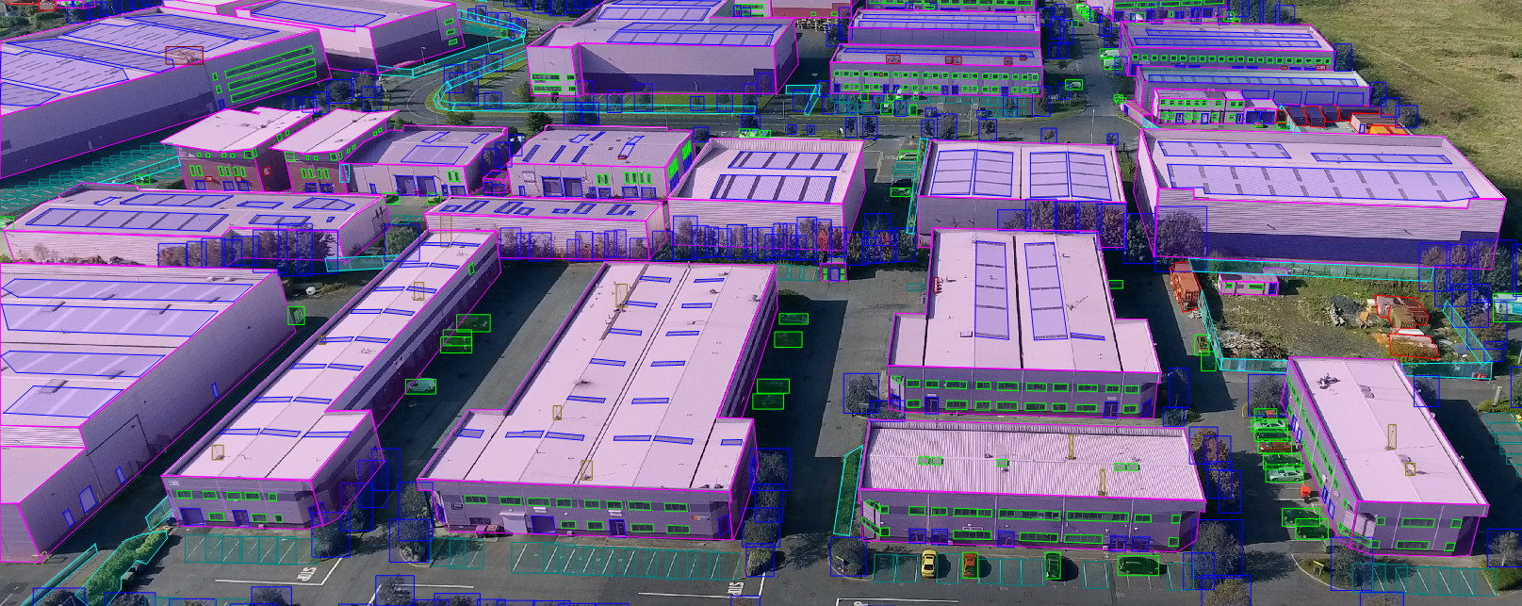
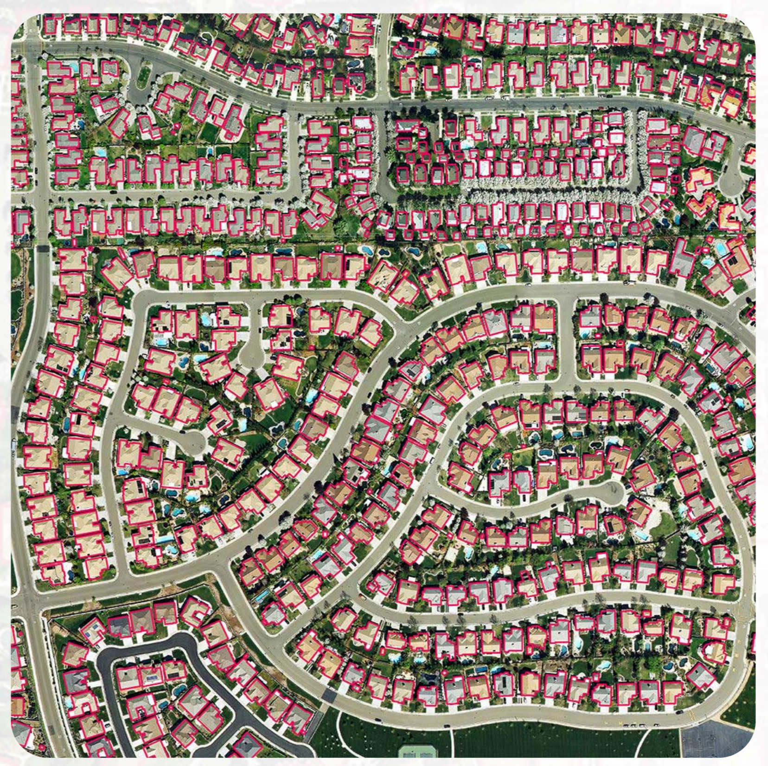
FUTURE PROSPECTS

